Slide 1
Inter-Integrated Circuit (I²C) Bus Interface AKA: Two Wire Interface (TWI)

Slide 2
Brief History
Designed in 1982 by Philips Semiconductor (now NXP)
1992 - First public Spec released
Since 2006 no licensing fees are required
Widely adopted technology

Slide 3
Why I²C?
Pins are precious!
They take up space
More pins → More expensive microcontrollers
Adding pins is hard
Might need a new microcontroller (if a larger, compatible one is available)
Significant board changes
Performance is often not that important
So
Use the minimum number of pins
Run them at relatively low bit rates.

Slide 4
Applications
Connecting to all kinds of small, slow peripherals
Reading Configuration data from various devices (Memory, PCI cards)
Accessing ADCs and DACs
Reading from Real-time clocks
Reading hardware monitoring devices (Fan speed, CPU Temperature, Accelerometers)
Controlling power supplies for various system components
GPIO expanders
Many, many others

Slide 5
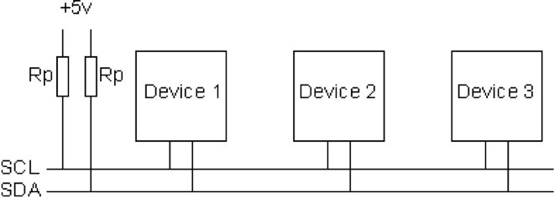
I²C Bus Architecture
Two signals
SCL – Serial Clock (used for coordination and timing)
SDA – Serial Data (used for data and control signaling)
Up to 1008 peripherals
1 or more “masters” that initiate communication on the bus
Up to 127 “slaves” that masters communicate
Bit rates
100 KHz (Standard mode)
400 KHz (Fast Mode)
3.4 MHz (High speed mode)
1 MHz (Fast Mode Plus)
5 MHz (Ultra fast mode)

Slide 6
I²C Addressing
Each slave on an I²C bus has a unique address.
Most use 7 bit addresses (we discuss this here)
An extended 10-bit version also exists
The addresses usually fixed or only partially configurable
E.g. Only the least-significant bit of the address for the IMU is settable. So you can only have two of these IMUs on one bus.
Different devices will have different numbers of settable and fixed bits.
You can’t mix components arbitrarily on the bus

Slide 7
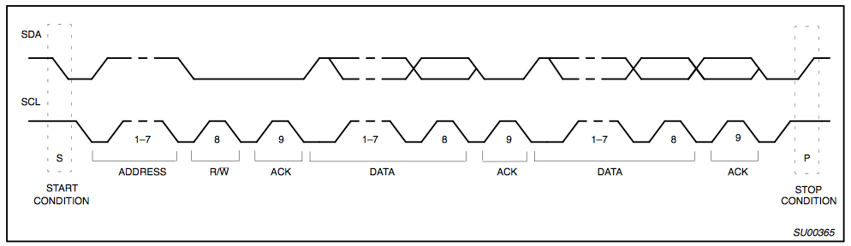
I2C Protocol - Full Xfer
Start
Philips I2C Bus Specification

Slide 8
I2C Protocol - Full Xfer
Address
R/W
Philips I2C Bus Specification

Slide 9
I2C Protocol - Full Xfer
Data
Philips I2C Bus Specification

Slide 10
I2C Protocol - Full Xfer
Stop
Philips I2C Bus Specification

